Slide 1
Cleaning the Galaxy
Trying to determine the error of the Hubble Space Telescope
Leslie Raganit

Slide 2
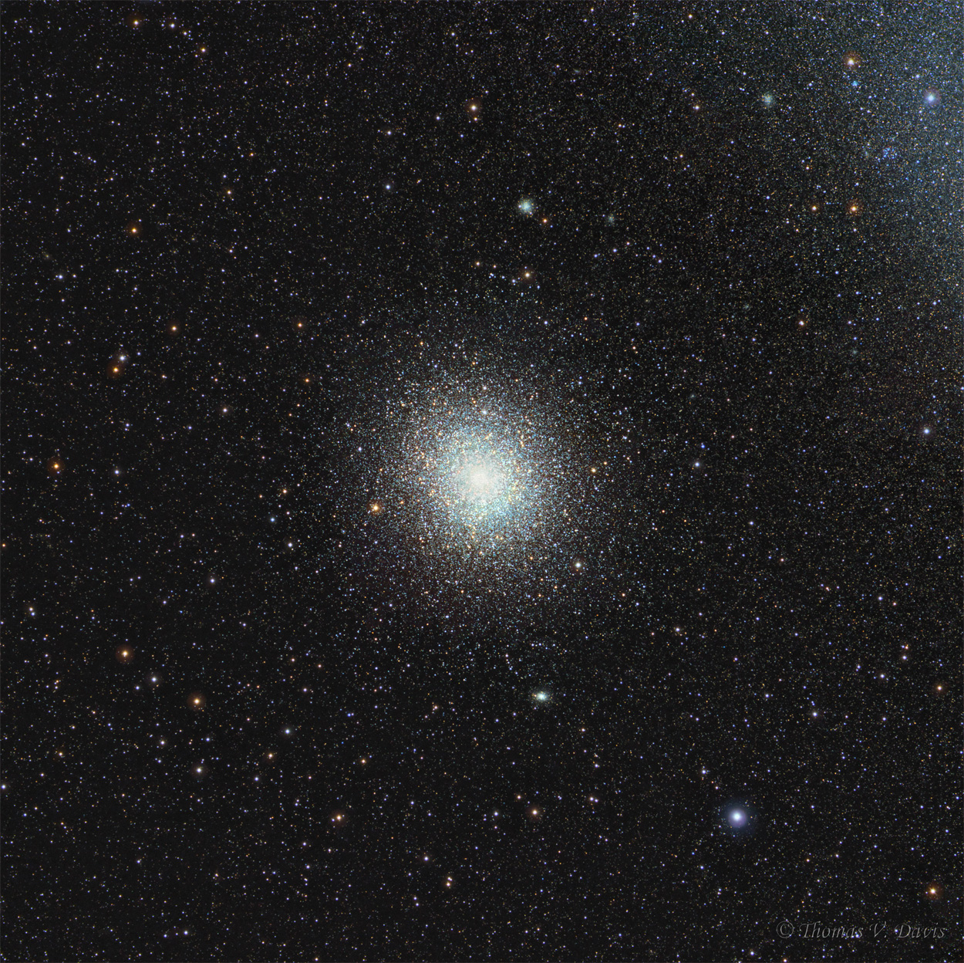
Introduction
47 Tucanae or 47 Tuc: a globular cluster found in the constellation Tucanae in the southern hemisphere

Slide 3
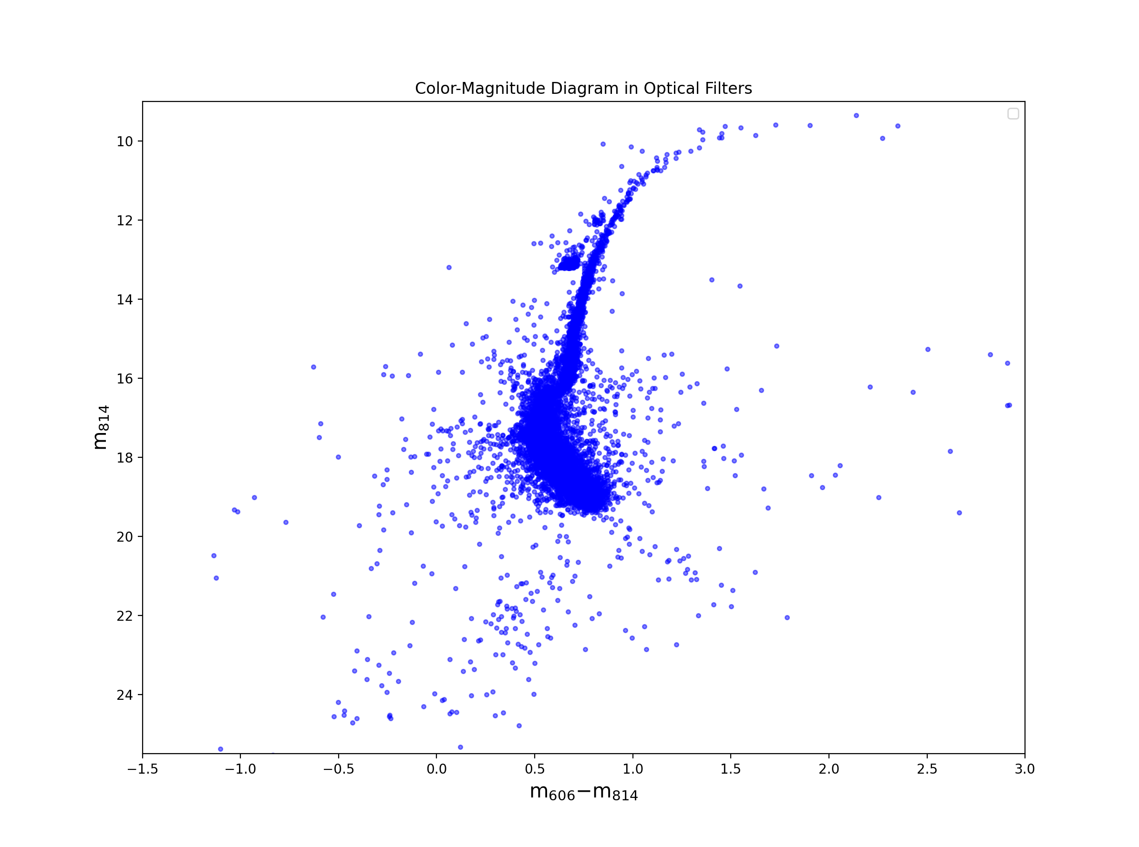
Crash landing on cmdS
EVERY STAR IS MAPPED ONTO CMDS
Y-axis: brightness of the star as measured on Earth
X-axis: Color and Temperature of the star
THE WIDTH OF THE MAIN SEQUENCE IS THE ERROR OF THE INSTRUMENT THAT TAKES THE DATA
WE’RE GOING TO REMOVE EXTERNAL ERROR

Slide 4
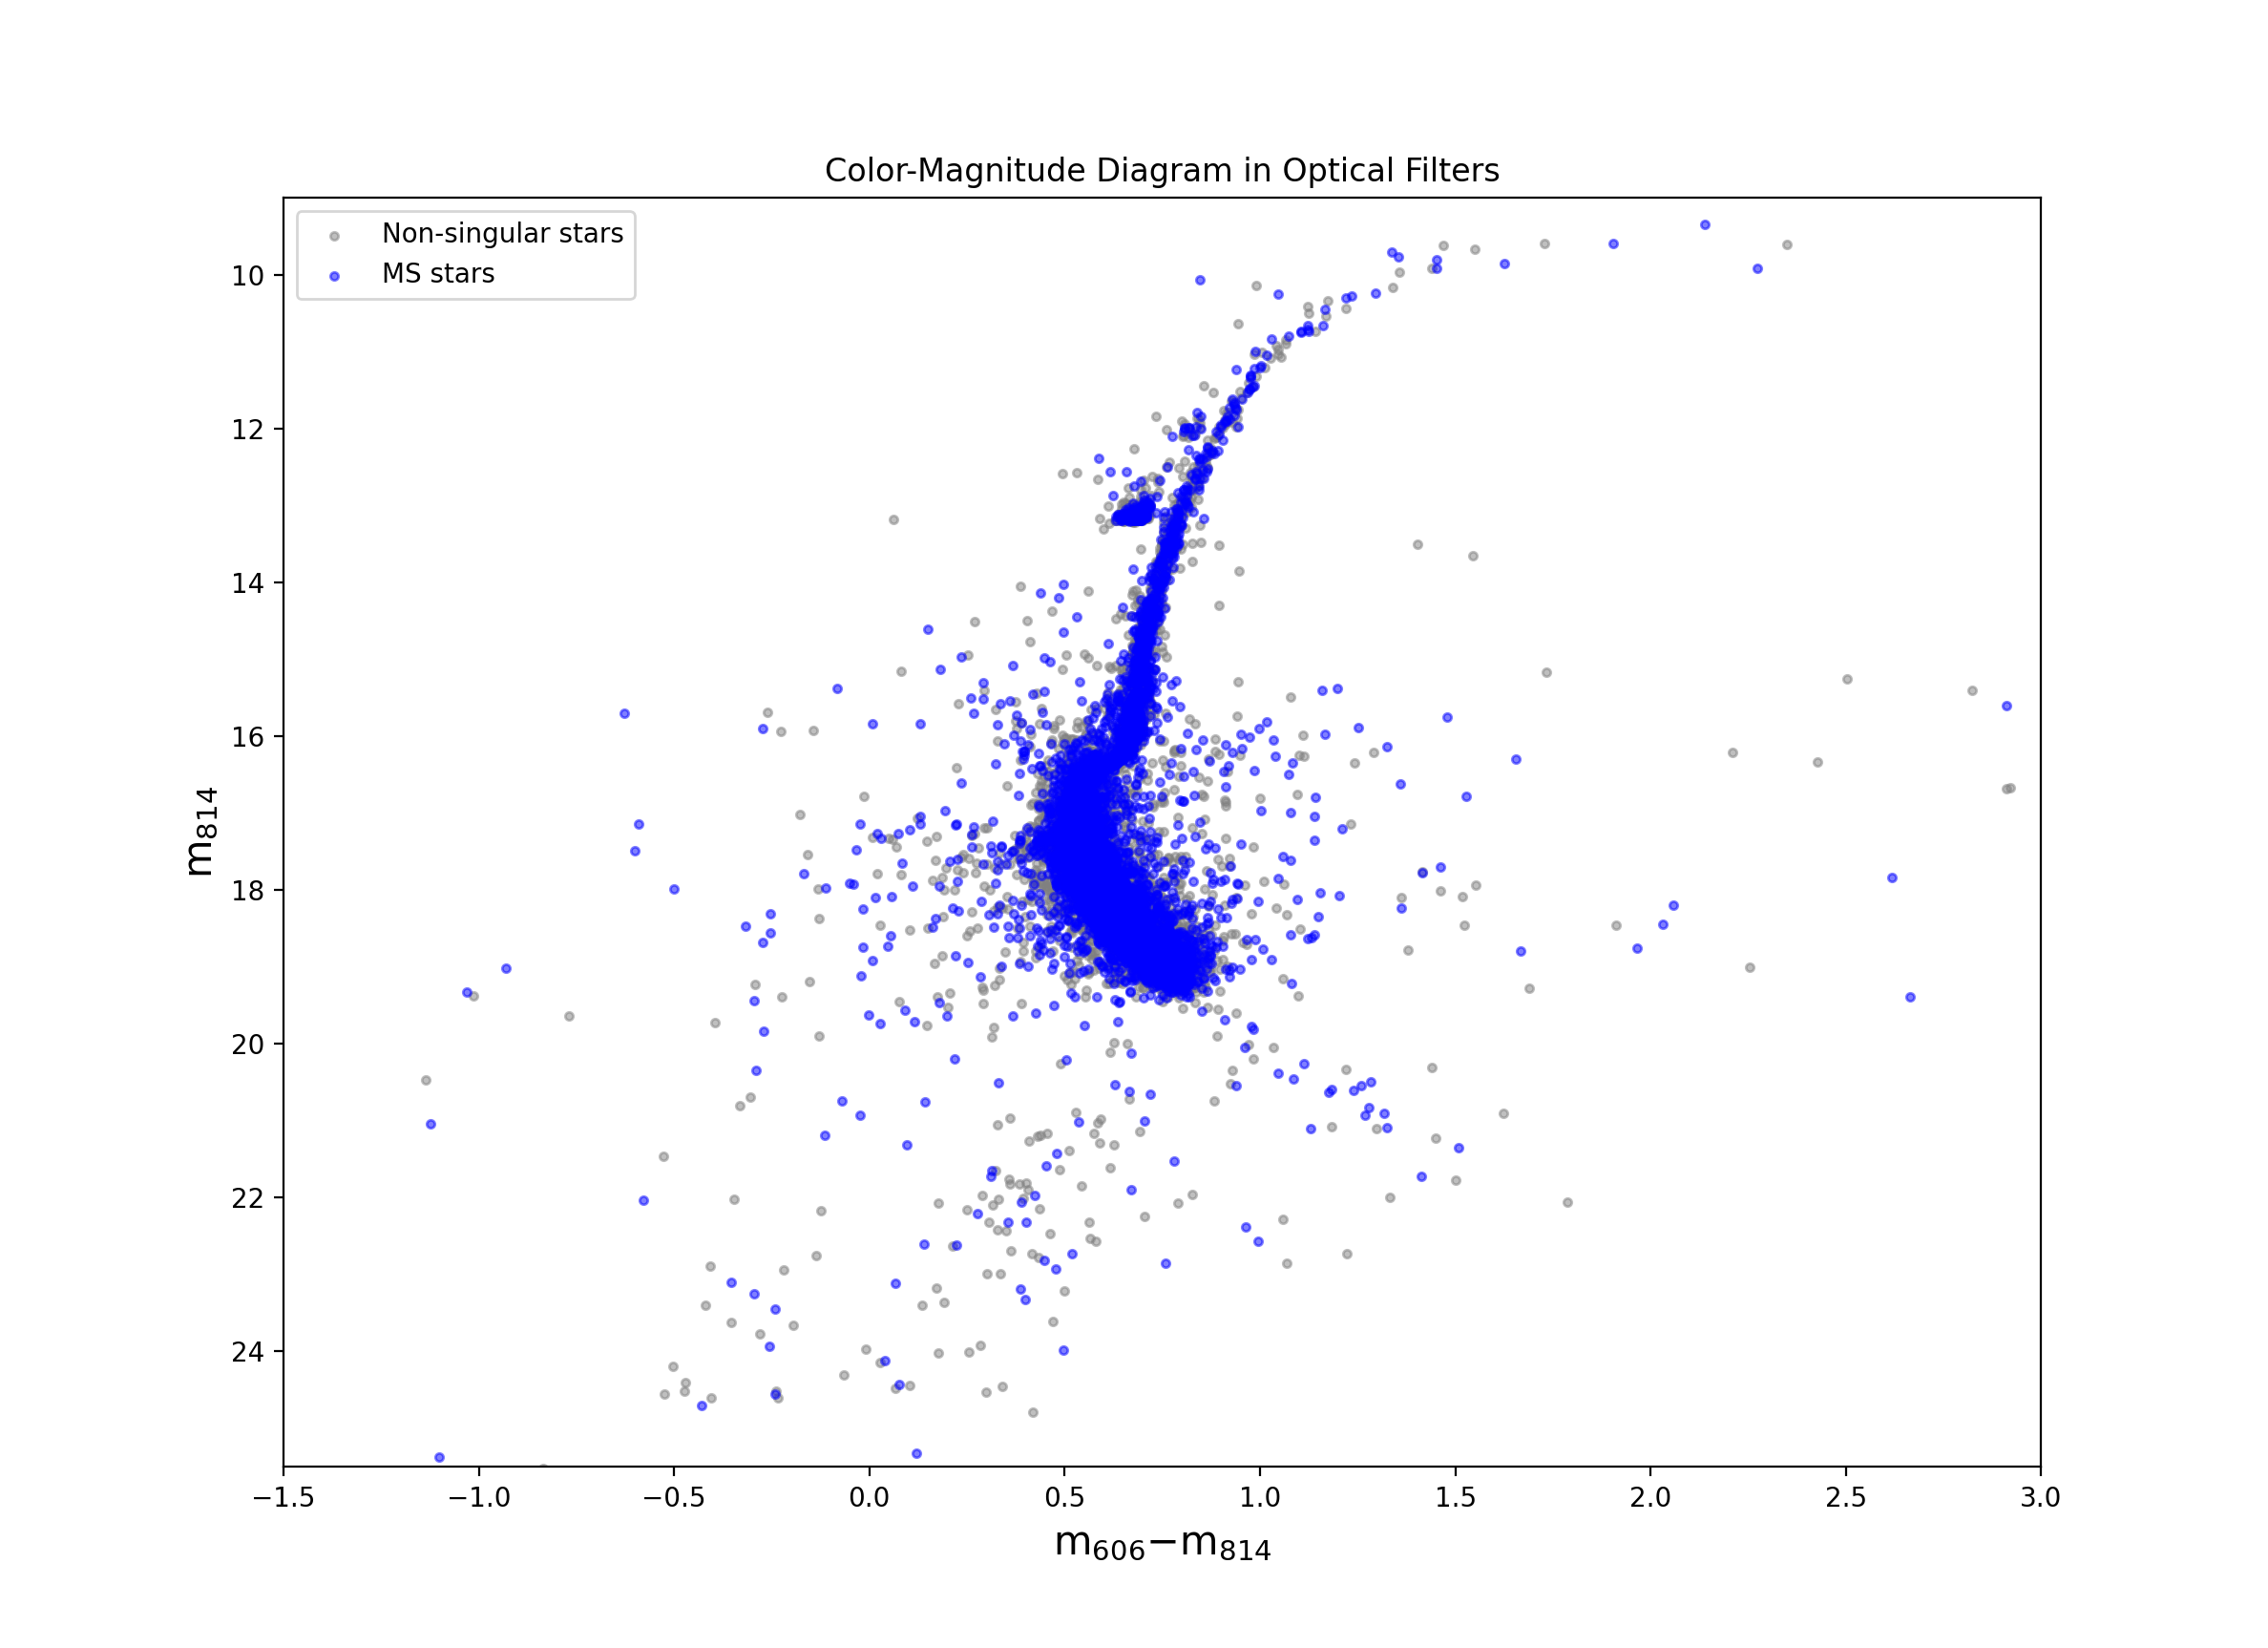
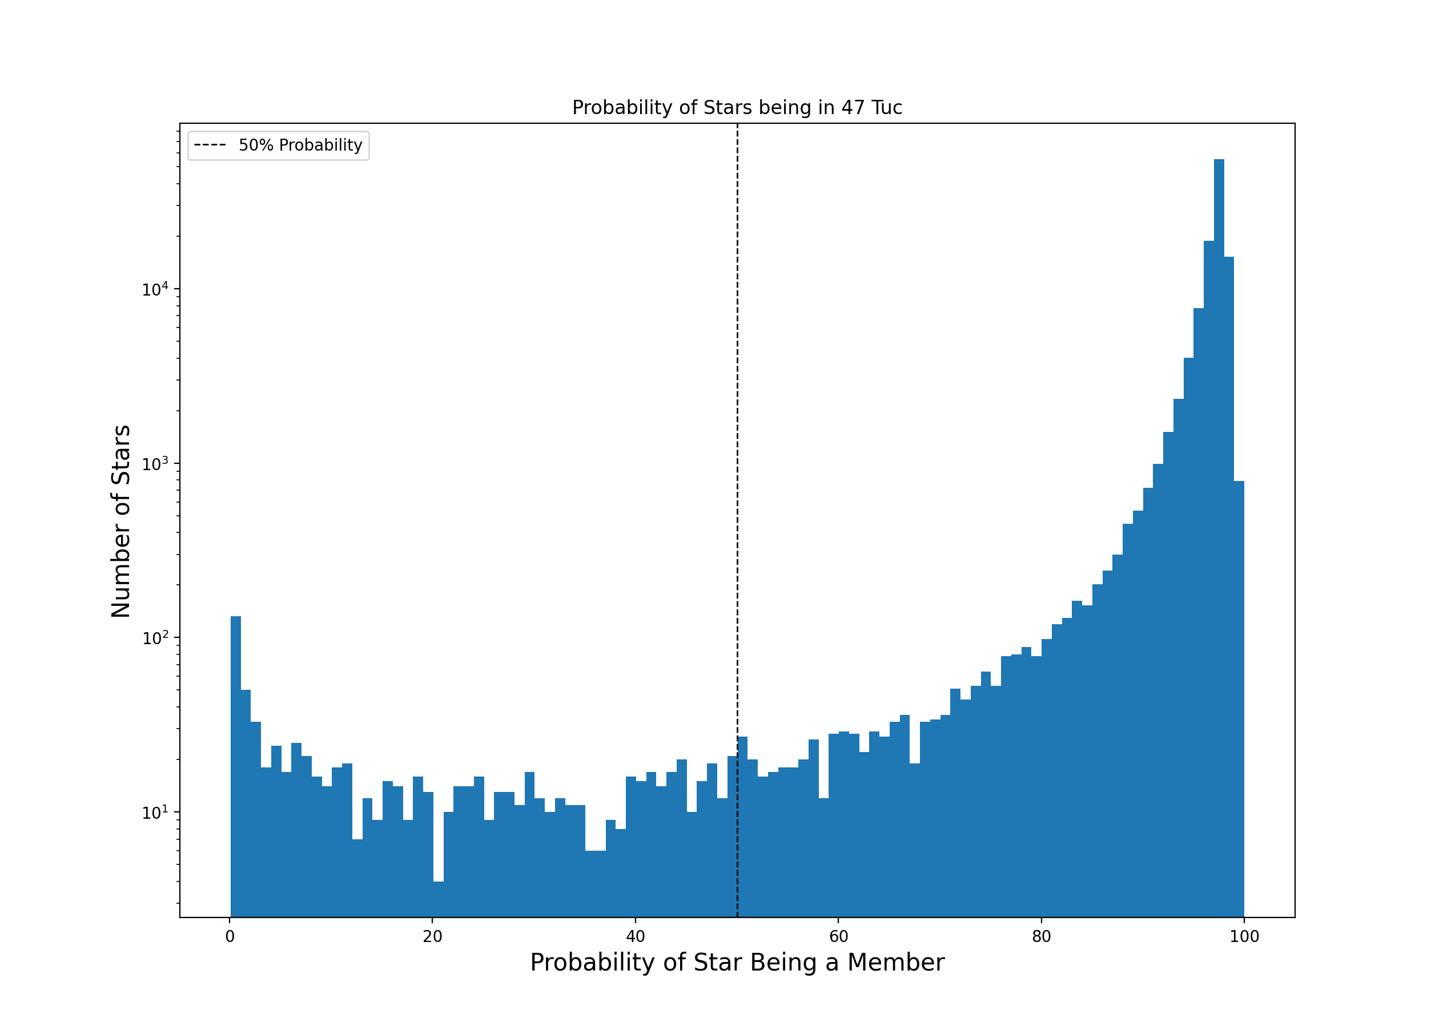
You can’t sit with us -removal of stars not in 47 Tuc

Slide 5
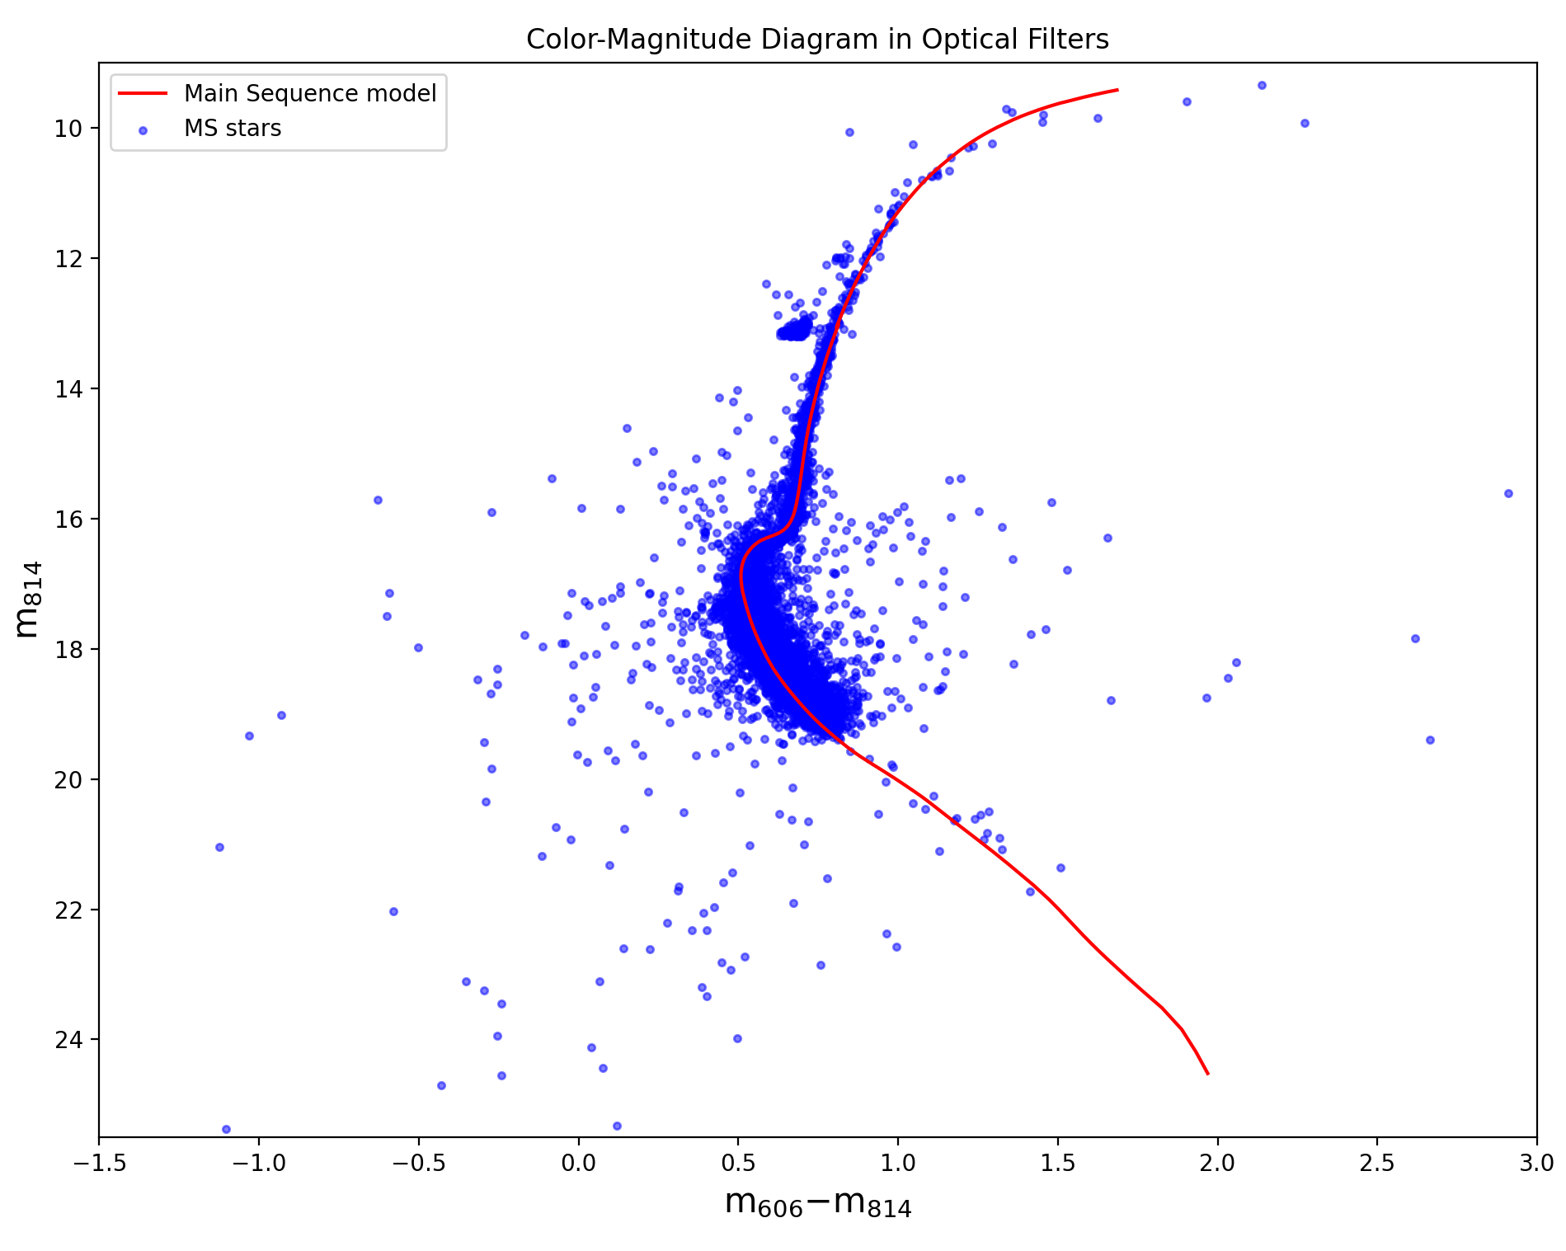
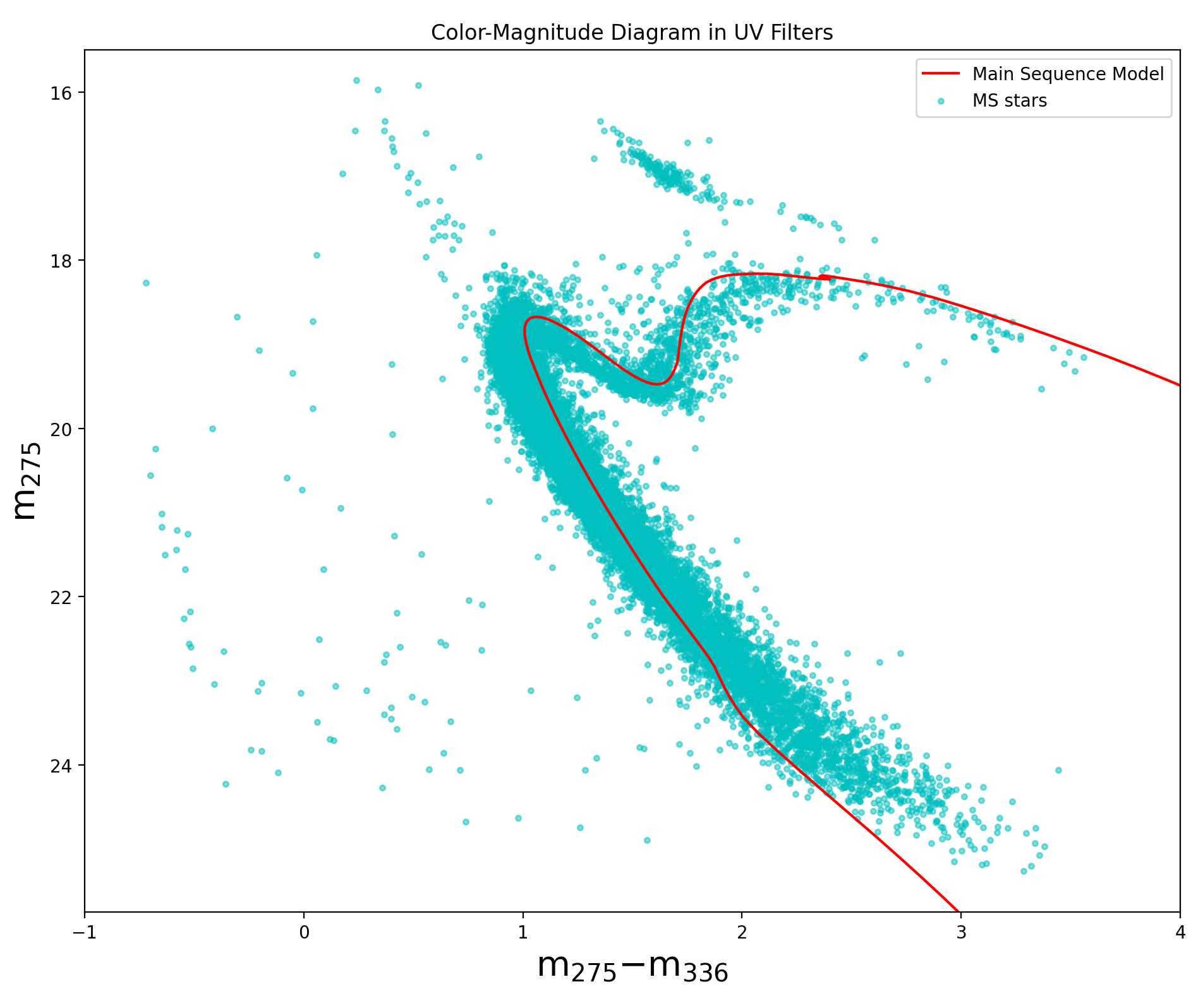
Follow the red brick road -Introduction into isochrones
Isochrones show where stars should lie if there isn’t any error in Hubble

Slide 6
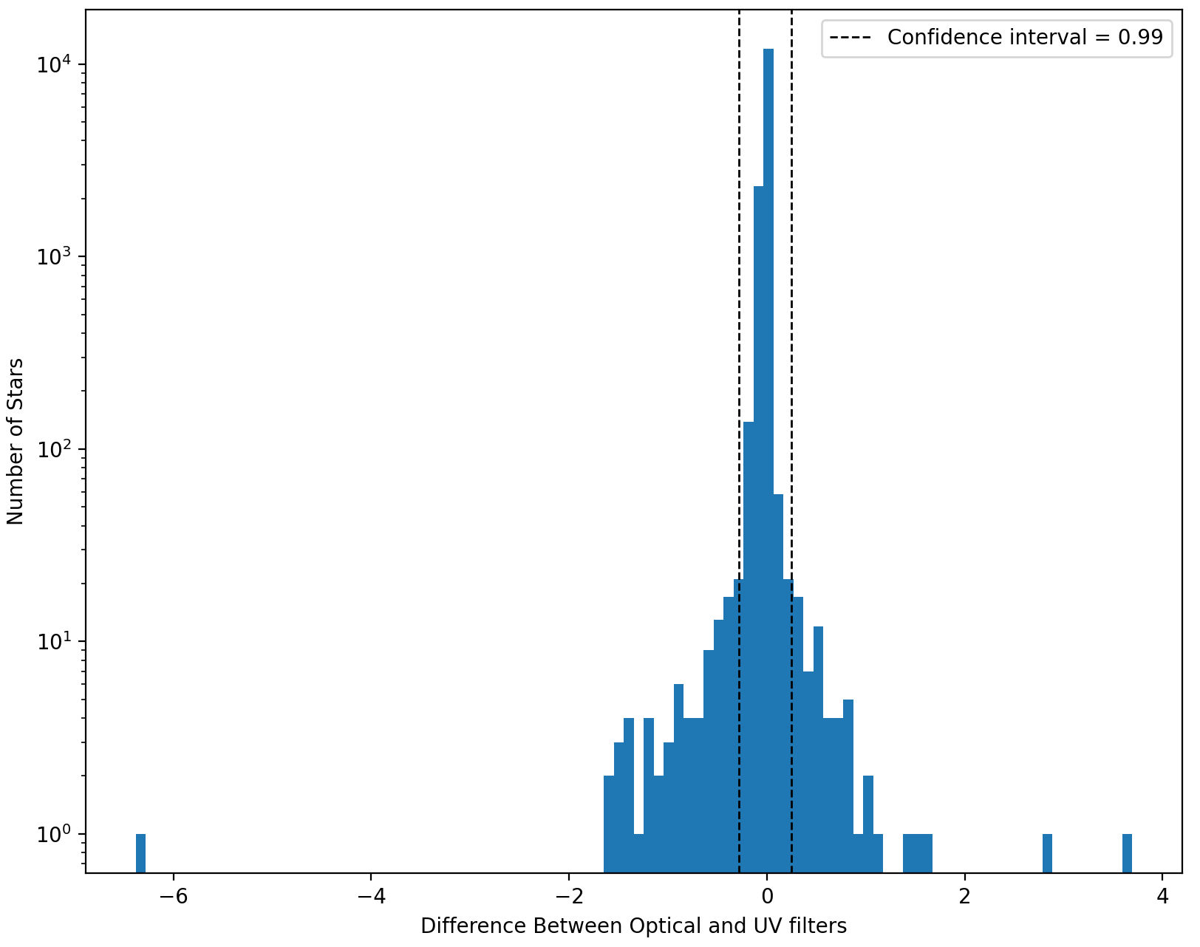
Prepare for trouble
Measured the difference between the the optical and UV filters
Stars that had a large delta were considered to be part of a non-singular light source
Y is measured in log to account for the the stars that do not account for a large portion of the data

Slide 7
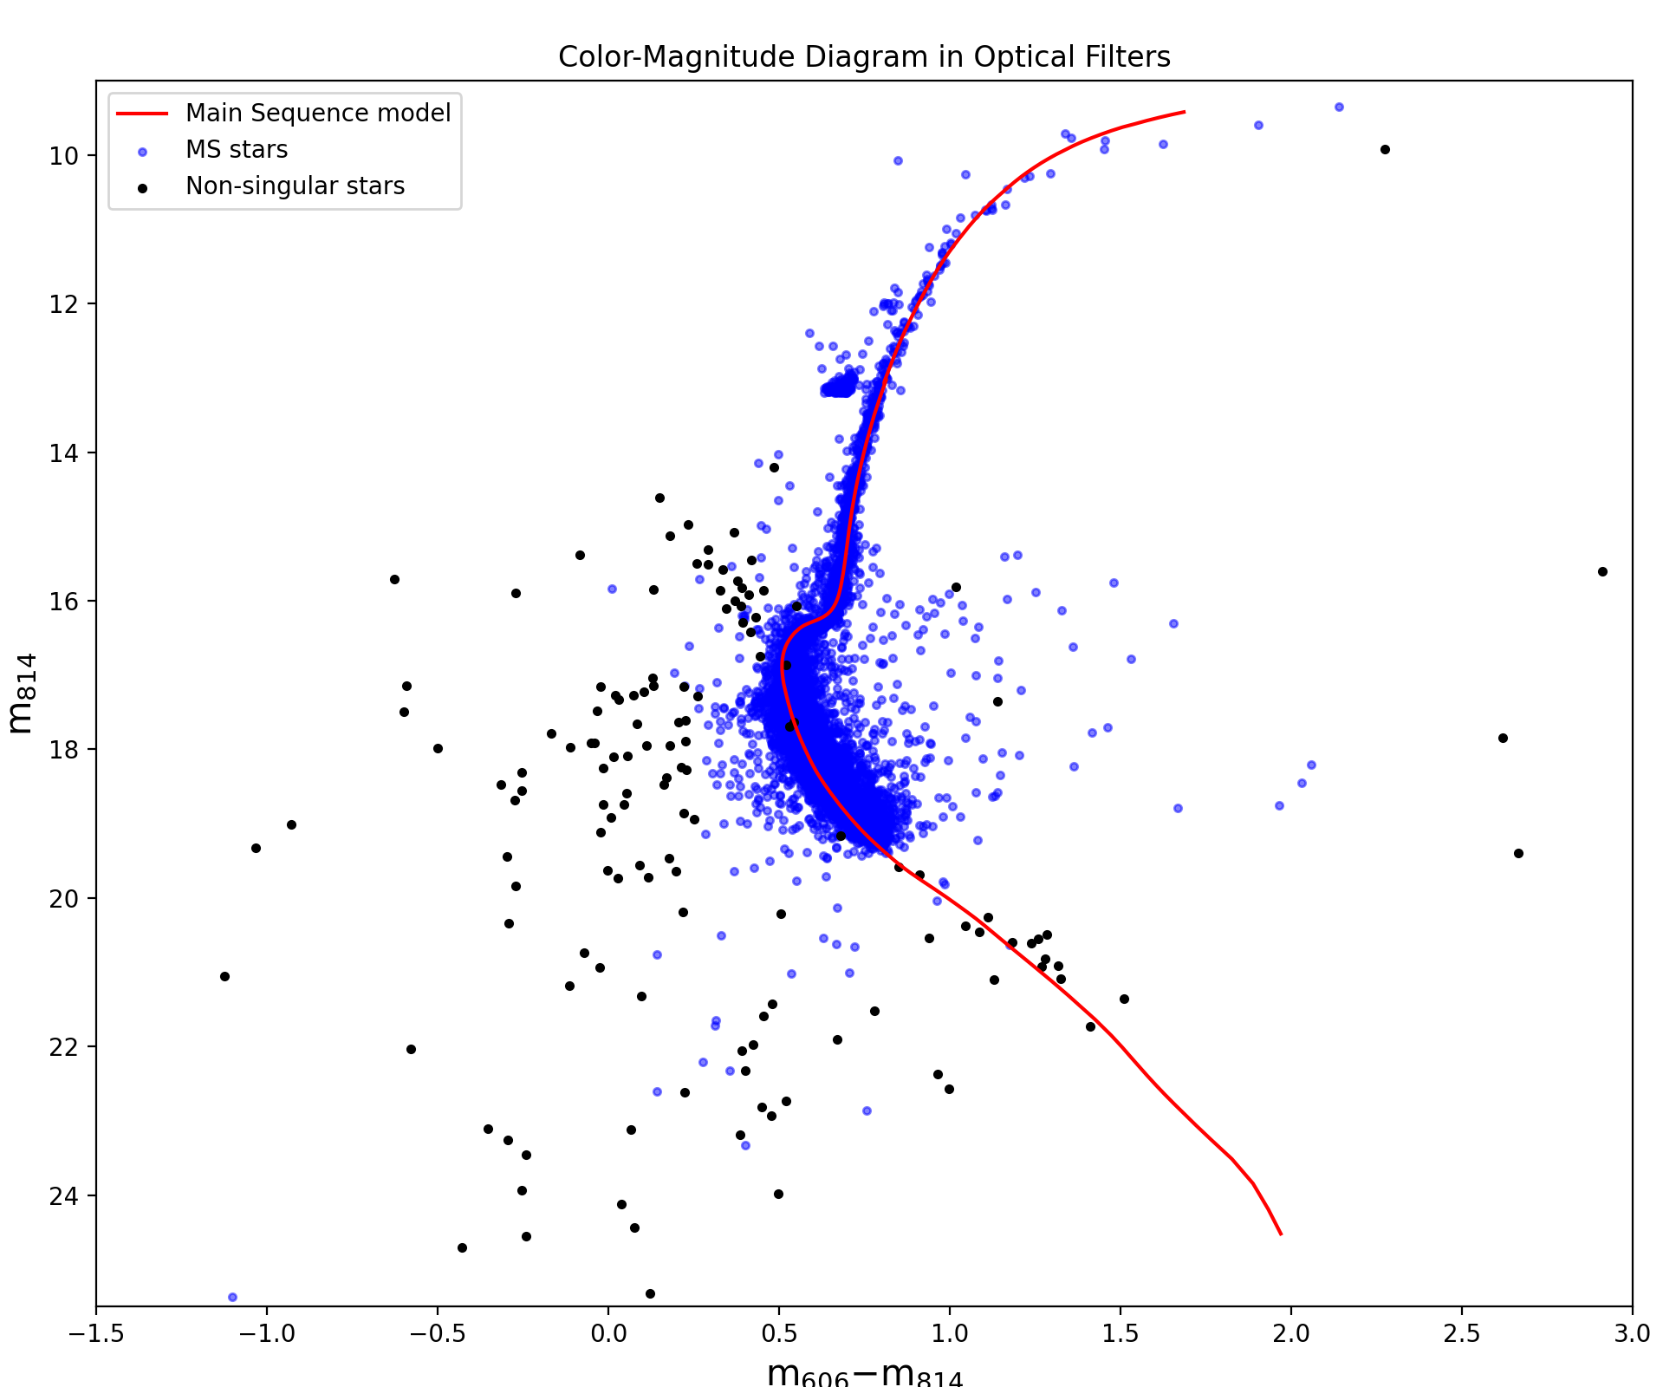
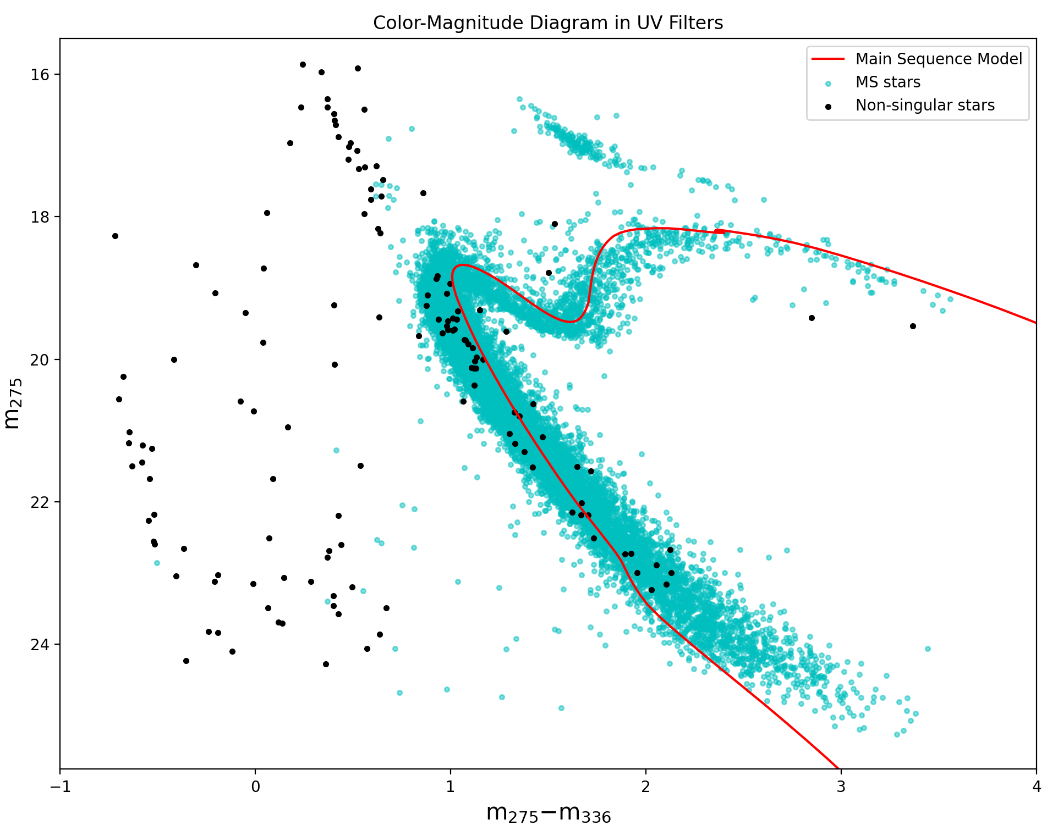
And make it double

Slide 8
Drumroll please!

Slide 9
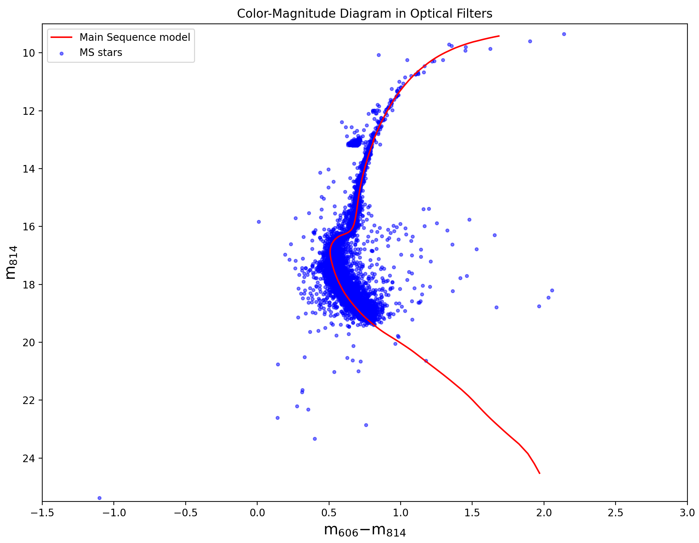

Slide 10
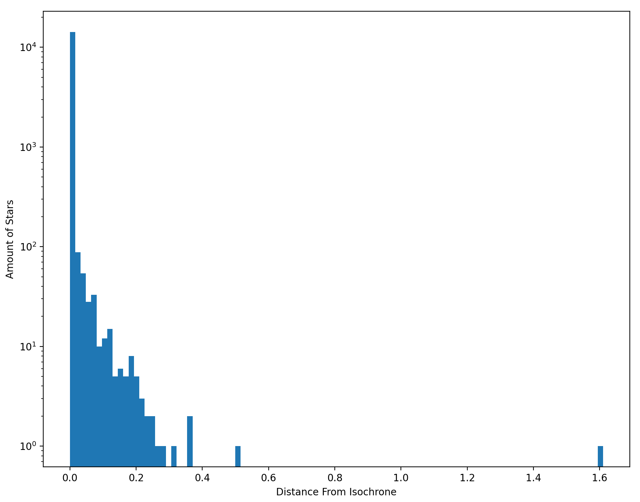
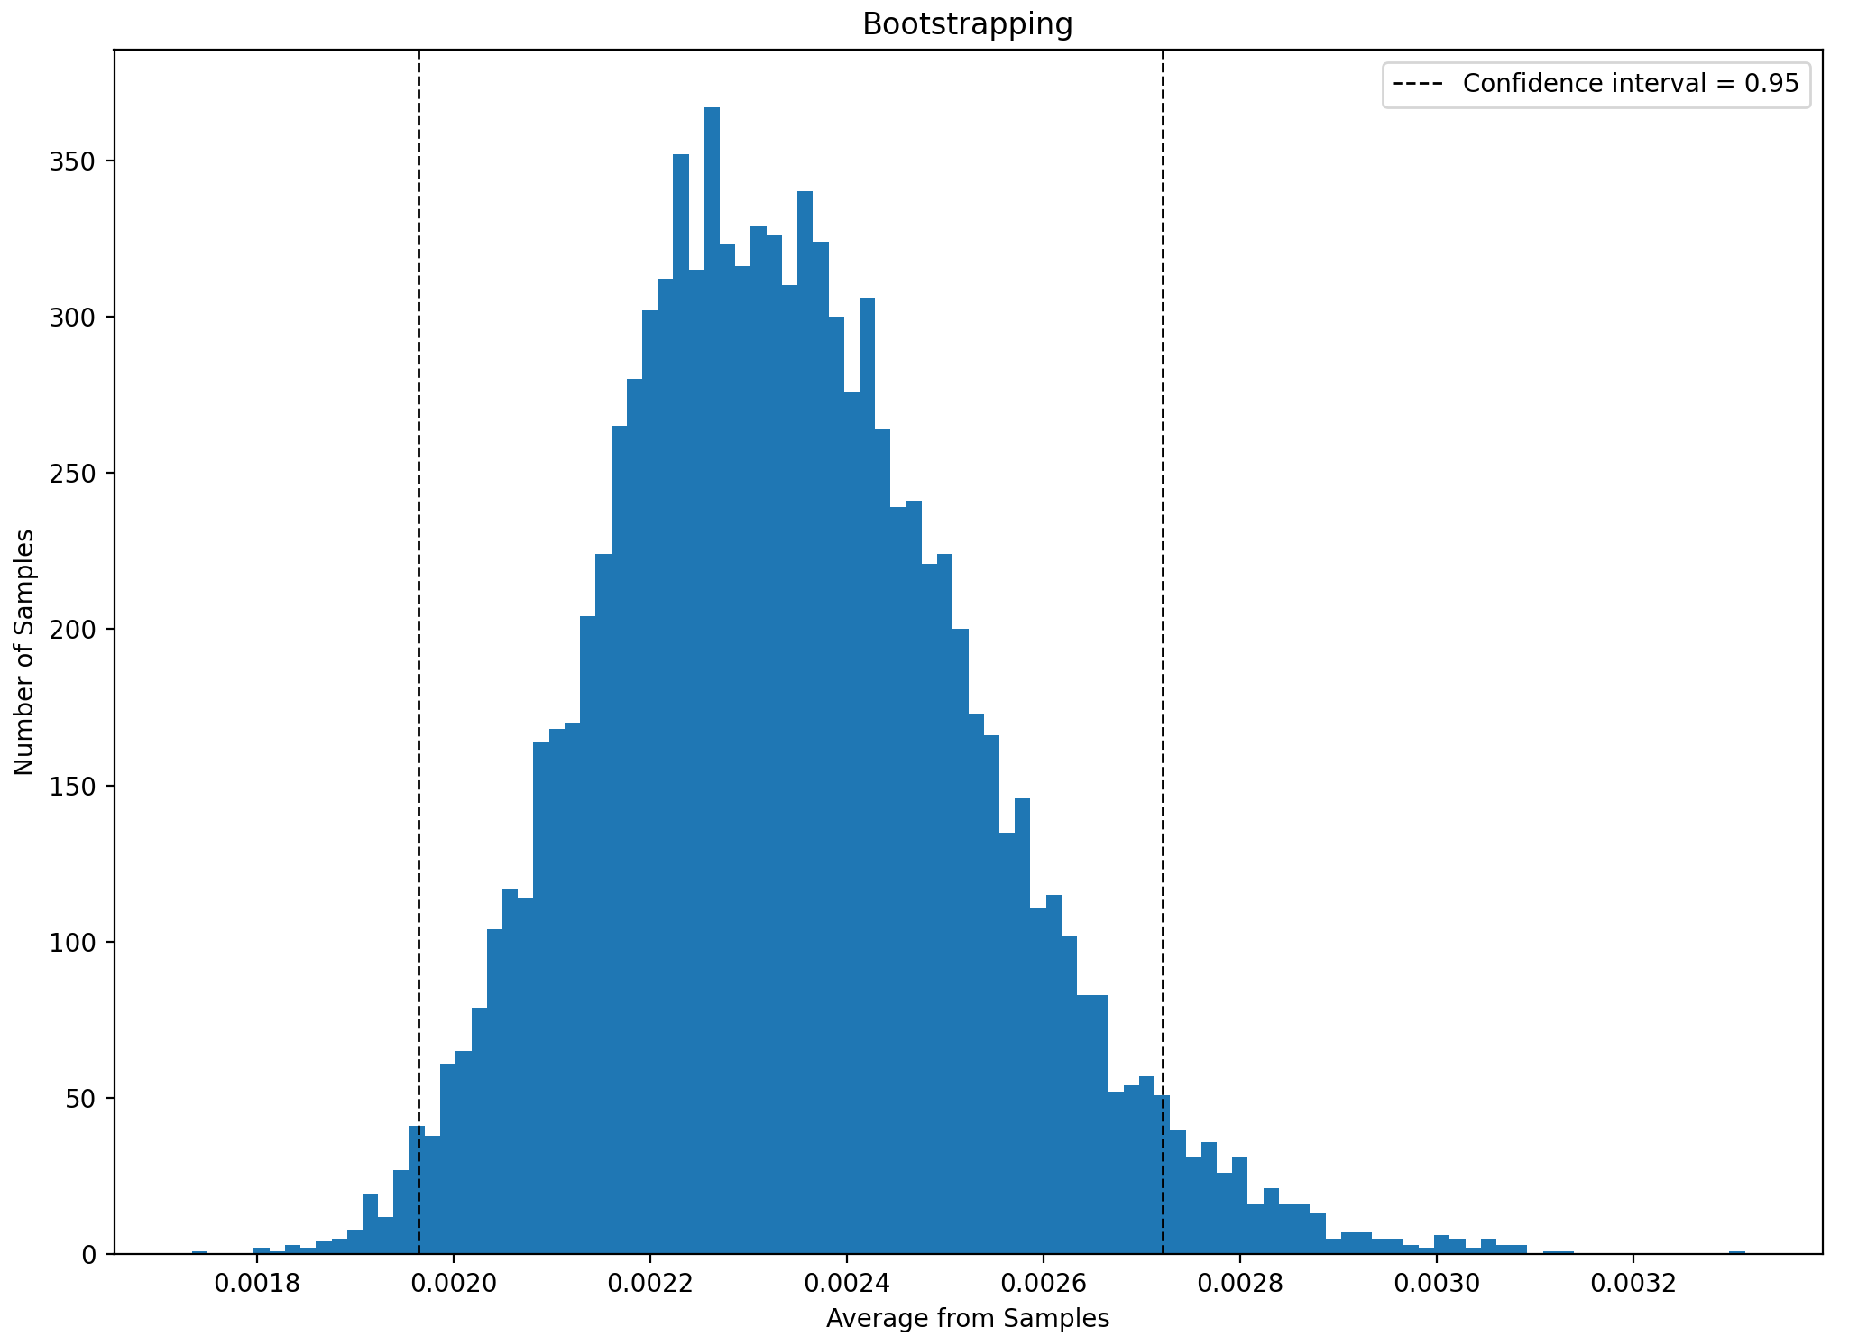
There’s a snake in my boot
Null Hypothesis: HST has no internal error (distance from each star to isochrone is zero)
Alternative Hypothesis: HST has error (distance is greater than zero)

